Slide 1
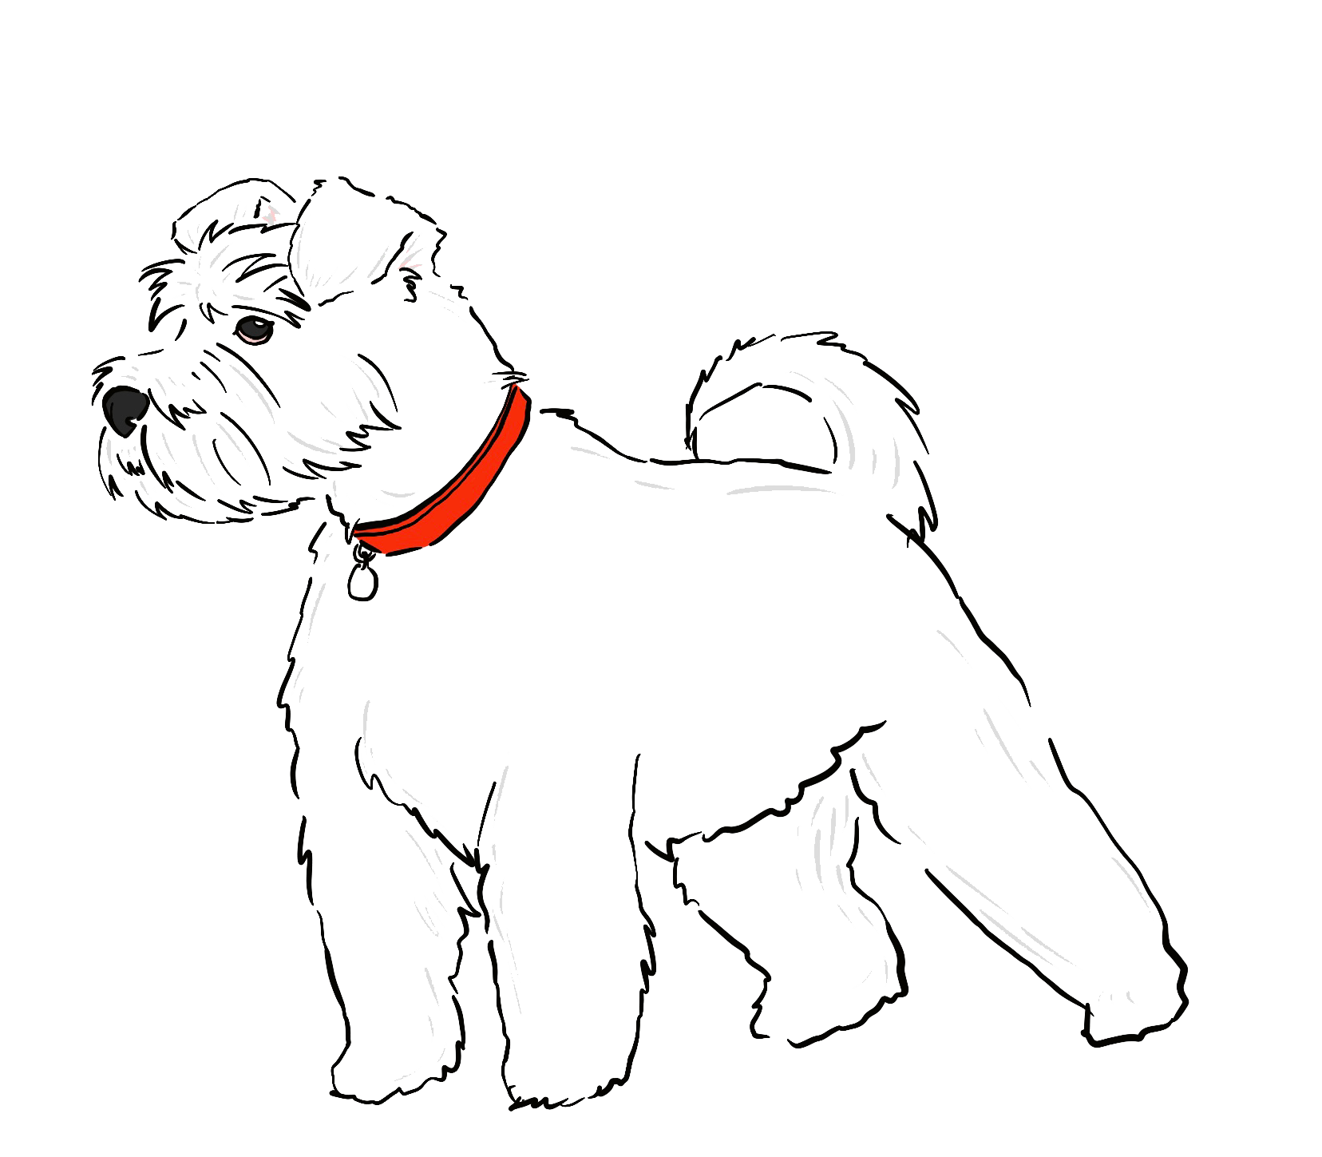

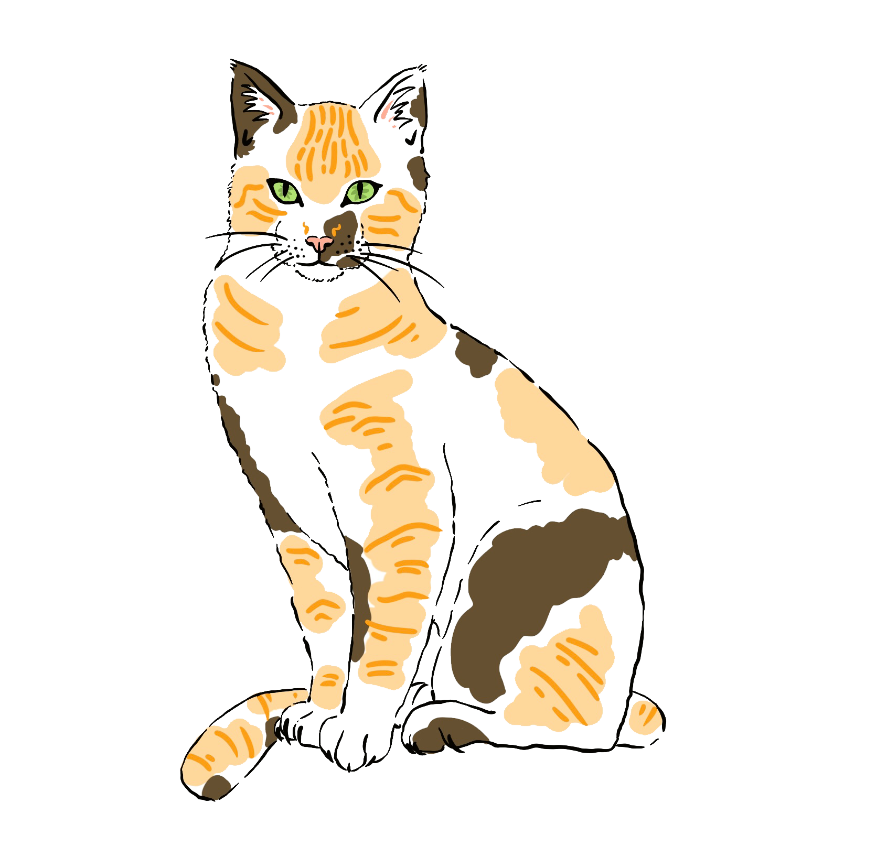
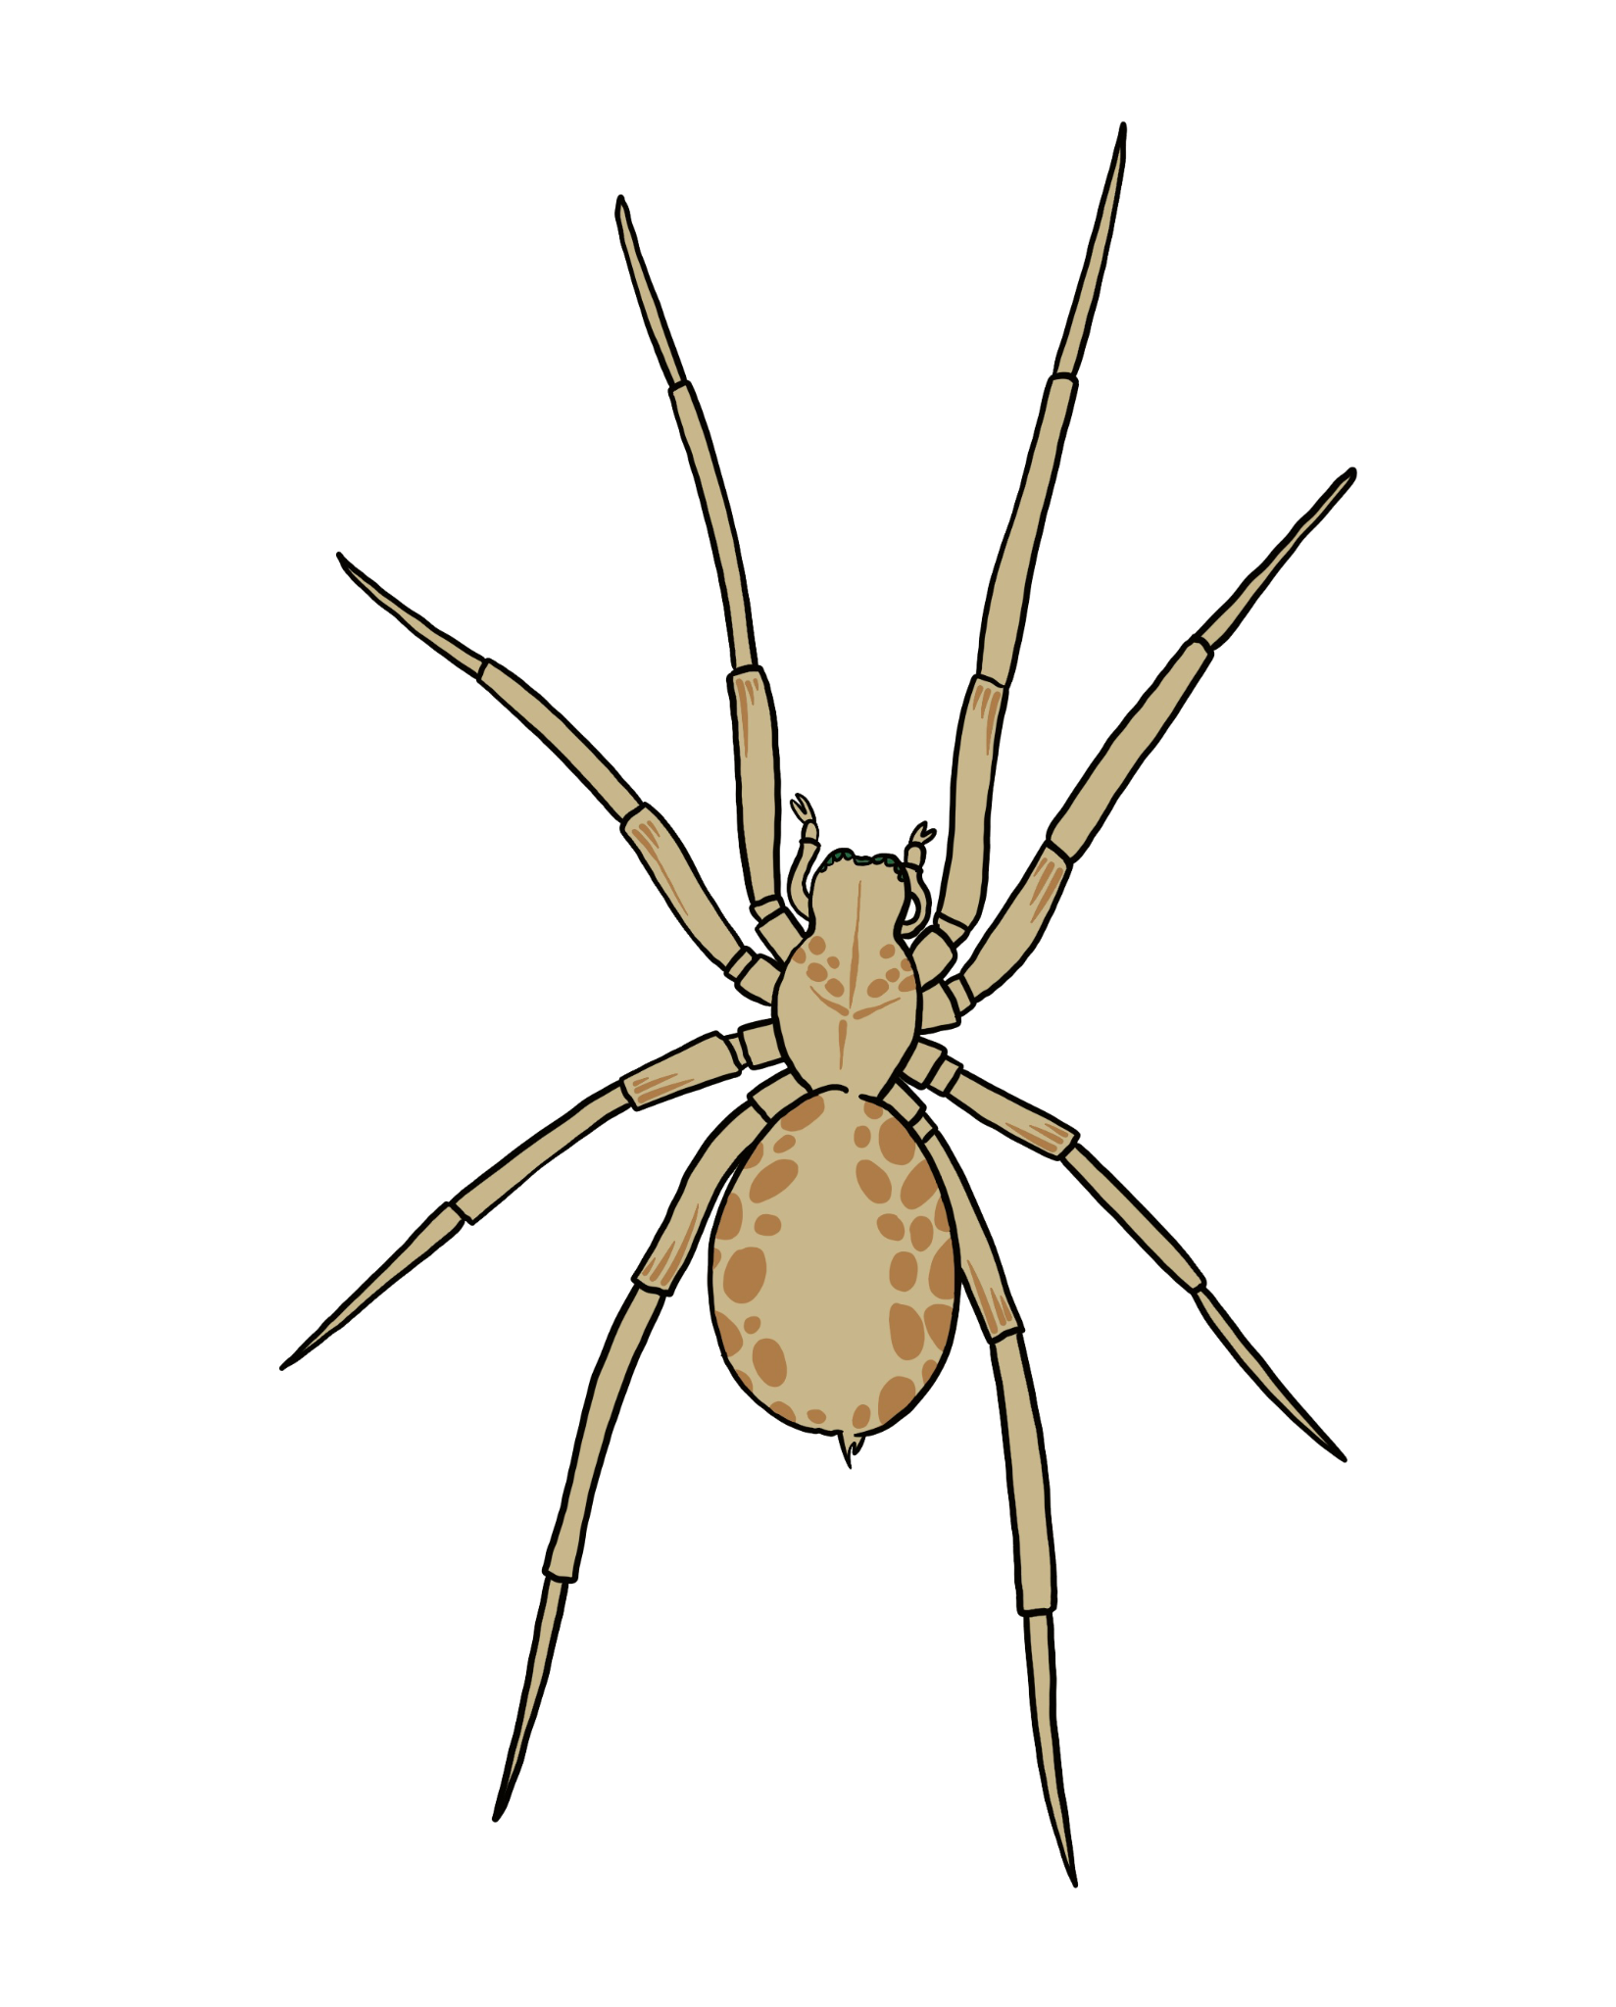
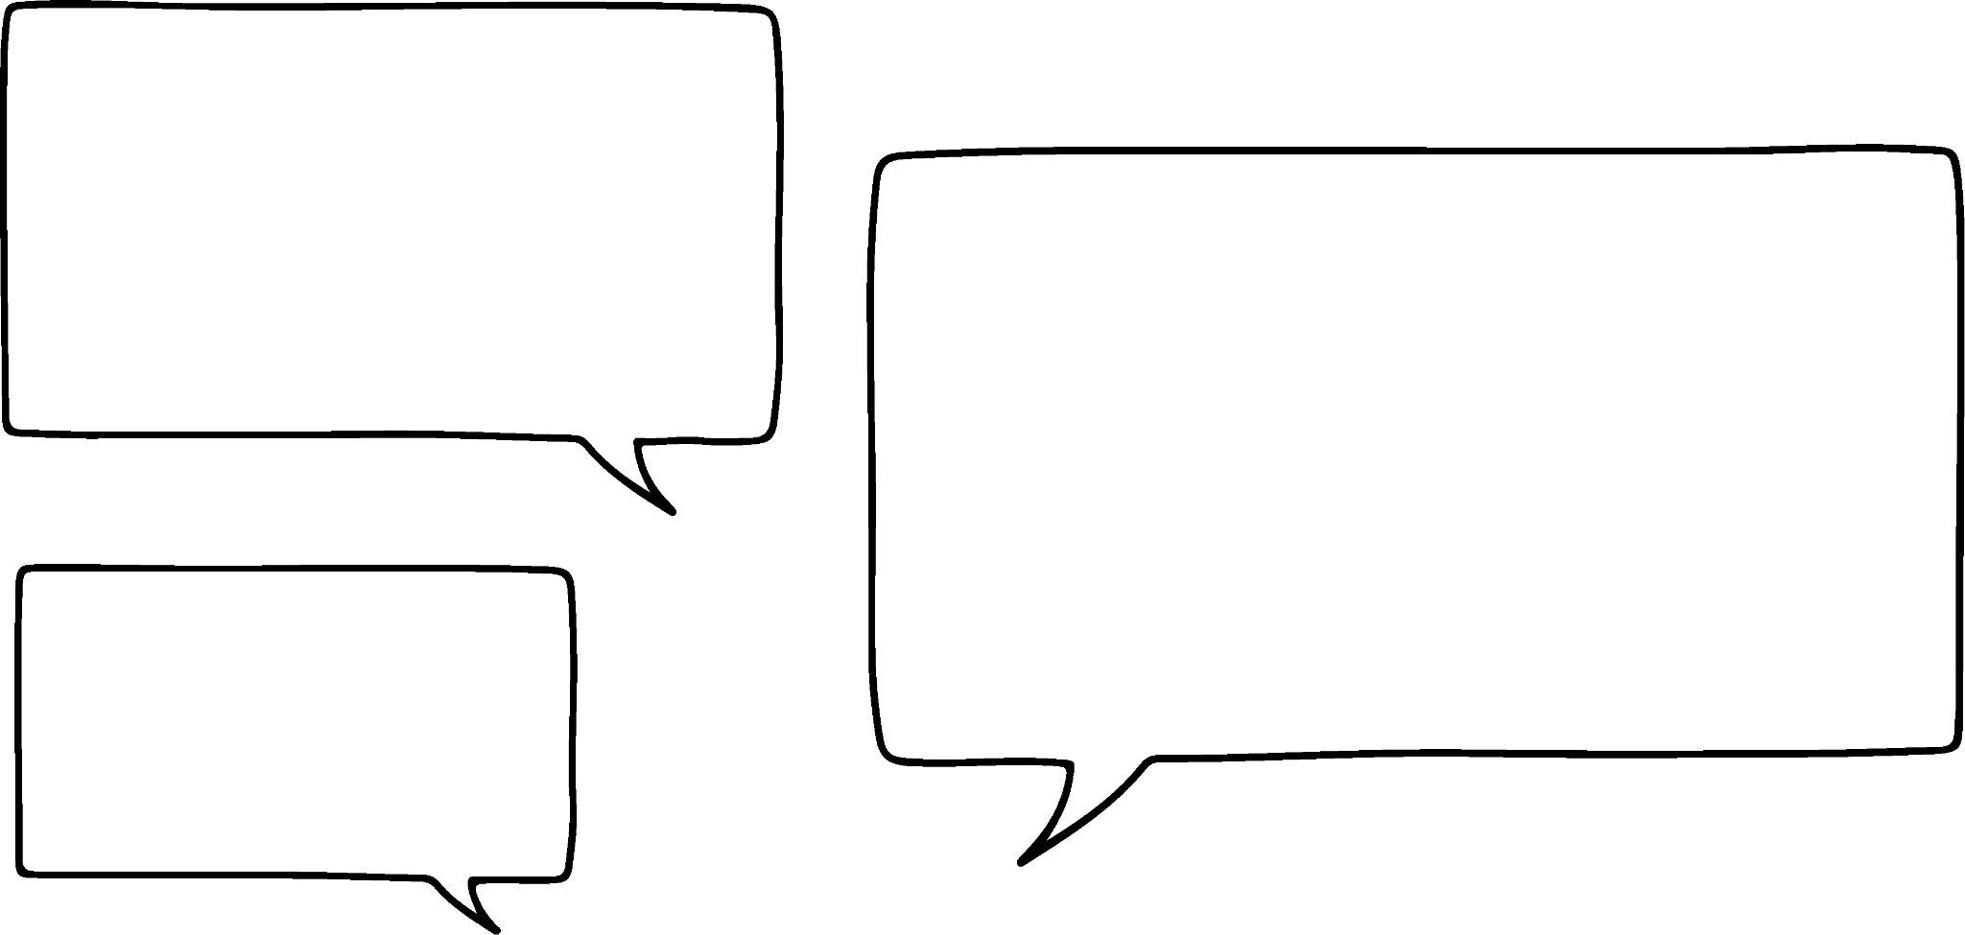

Understanding the mode
Task A: Finding a mode
1) What is the modal animal?
The spider as it appeared 4 times compared to 3 beetles, 3 cats and 2 dogs.
2) In this set of data, what is the mode? 0, 0, 0, 0, 0, 1, 1, 1, 1, 1, 1, 2, 2, 2, 3, 3, 3, 3, 3, 4, 4, 5, 5, 5, 5
1 is the mode, it appears 6 times which is the most occurrence compared to the other data
3) In this set of data, what is the mode? 12, 16, 18, 12, 19, 18, 15, 16, 18, 19, 12, 12, 18, 15, 18
Ordering the data, shows the repeats more clearly:
12, 12, 12, 12, 15, 15, 16, 16, 18, 18, 18, 18, 18, 19, 19
The mode is 18.
I rolled a 6 ten times; I rolled a 7 twelve times; I rolled an 8 ten times.
4) Sofia was rolling an eight-sided dice. What was the mode roll on the dice?
7 is the mode roll. It occurred 12 times compared to 10 times of each 6 and 8.

Slide 2
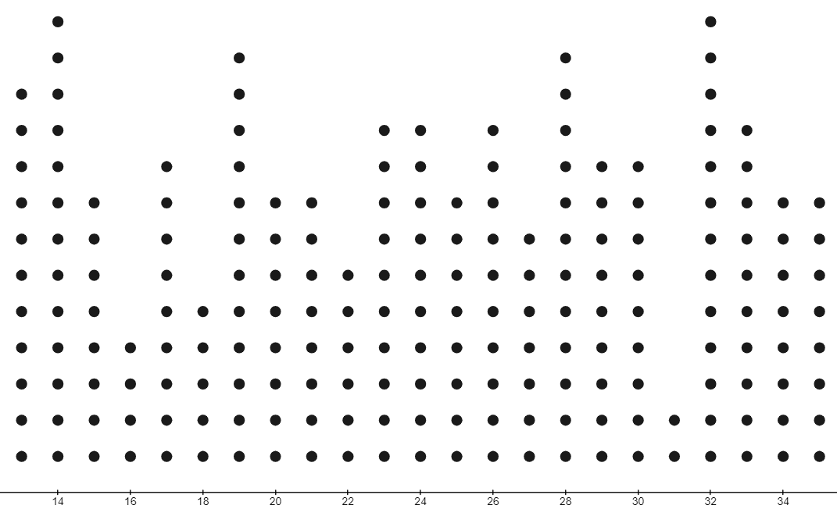
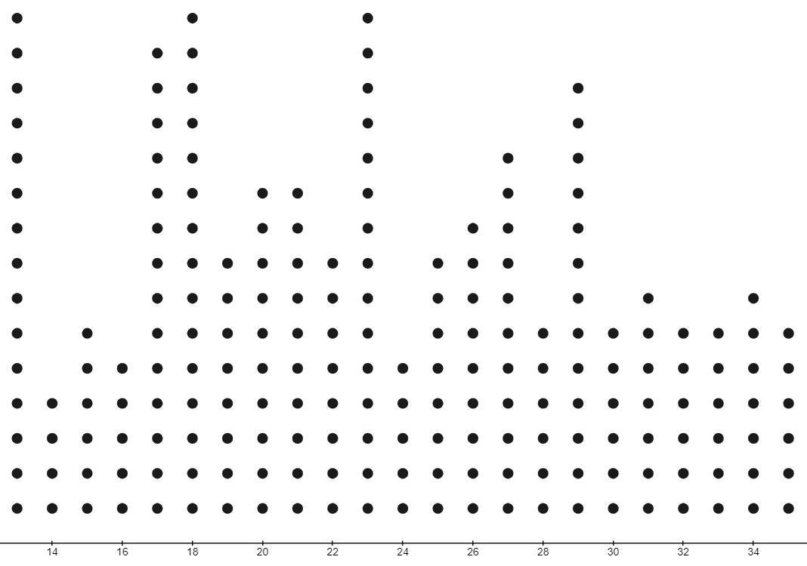
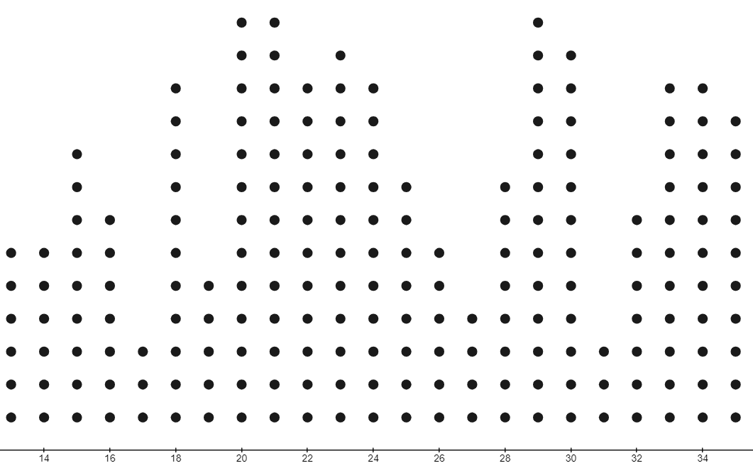
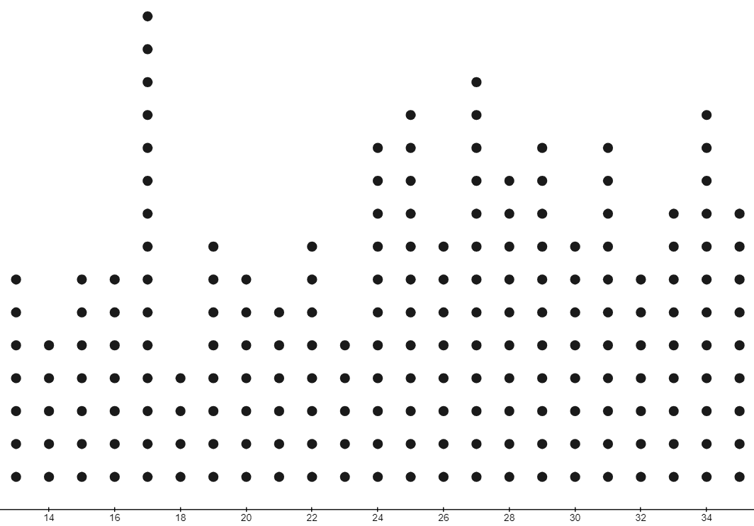
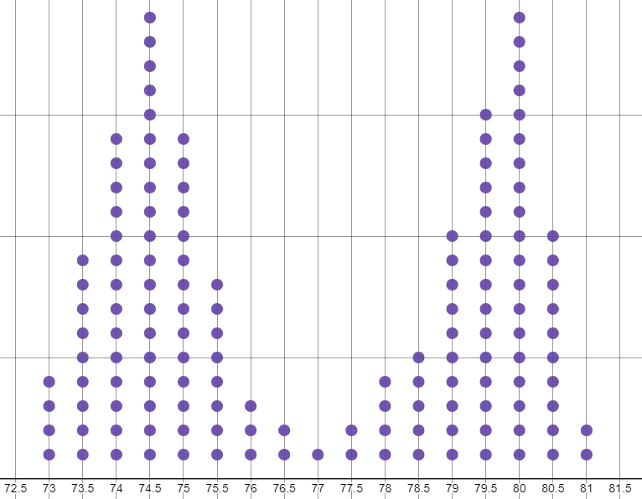
Understanding the mode
Task B: It is not always one mode
1) Write a data set of 20, that is bimodal.
2) Write a data set of 10, that has no mode.
3) Write a data set of 20, that is trimodal.
There are multiple correct answers for this. Two values should be repeated the same number of times as each other.
For example: 0, 0, 0, 1, 1, 2, 2, 3, 3, 3, 4, 4, 4, 4, 5, 5, 5, 5, 6, 6
There are multiple correct answers for this. Nothing should occur more than anything else.
For example: pink, white, red, blue, green, orange, brown, yellow, purple, teal
There are multiple correct answers for this. Three values should be repeated the same amount as each other.
For example: 0, 0, 1, 1, 2, 2, 3, 3, 3, 3, 4, 4, 4, 4, 5, 5, 5, 5, 6, 6
4) For each data set, write how many modes the data has, if any.
bimodal - 2 modes
trimodal - 3 modes
trimodal - 3 modes
1 mode
5) What is the mode of the data shown on this dot plot?
The data is bimodal.
The modes are 74.5 and 80.
Mathematics in Education and Industry
v2.2

